Slide 1


Slide 2
Career planning
Career planning is an ongoing process through which an individual sets career goals and identifies the means to achieve them.
The process which an individual plan their work life is referred to career planning.

Slide 3
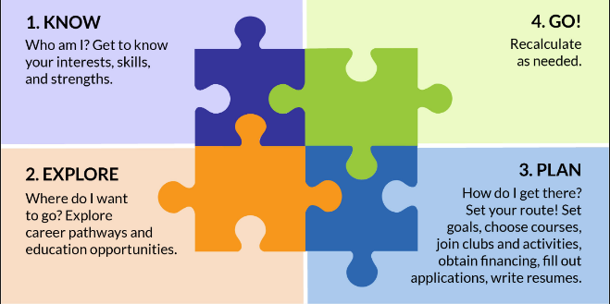
Basic career planning process

Slide 4
For career planning process what do we need!
For the process of career , an individual need career anchors.
Career anchor denotes the basic drives that create the urge to take up certain type of a career.

Slide 5
Career Anchors are
Managerial Competence: Person having this drive seek managerial positions that provide opportunities for higher responsibility, decision making, control and influence over others.
Technical Competence: People having this anchor seek to make career choices based on the technical or functional content of the work. Career in specialized area such as quality control, engineering, accounting, advertising, public relations etc.
Creativity: This drive provides entrepreneurial and innovative opportunities to the people. People are driven by an overwhelming desire to do something new that is totally of their own making.

Slide 6
Steps in Career Planning Process
Step 1: Self-Assessment: The first and foremost step in career planning is to know and assess yourself. collect information about yourself while deciding about a particular career option. analyze your interests, abilities, aptitudes, desired lifestyle, and personal traits and then study the relationship between the career opted for and self. Step 2: Goal Setting Set your goals according to your academic qualification, work experience, priorities and expectations in life. Step 3: Academic/Career Options Narrow your general occupational direction to a particular one by an informatory decision making process. Analyse the career option by keeping in mind your present educational qualification and what more academic degrees you need to acquire for it.

Slide 7
Steps in Career Planning Process
Step 4: Plan of Action Recognize those industries and particular companies where you want to get into. Decide where you would like to see yourself after five years and in which position. Step 5: Catch Hold of Opportunities Opportunity comes but once. So, whenever you get any opportunity to prove yourself and get into your desired career, try to convert it in every way for suiting your purpose.

Slide 8
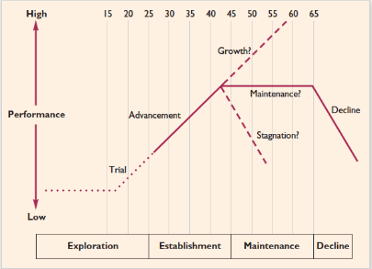
Different career stages

Slide 9
Different career stages
Exploration Stage: This is the stage where an individual builds expectations about his career. Some of them are realistic and some are not. But the fact is that these could be a result of the individual's ambitions.
Establishment Stage: This could be at the stage where the individual gets his first job, gets accepted by his peers, learns in this job, and also gains the first tangible evidence of success or failure.
The establishment/advancement stage tends to occur between ages 25 and 44. In this stage, the individual has made his or her career choice and is concerned with achievement, performance, and advancement.
This stage is marked by high employee productivity and career growth, as the individual is motivated to succeed in the organization and in his or her chosen occupation.
Opportunities for job challenge and use of special competencies are desired in this stage.
The employee strives for creativity and innovation through new job assignments.
Employees also need a certain degree of autonomy in this stage so that they can experience feelings of individual achievement and personal success.

Slide 10
Different career stages
Mid-Career Stage: The individual's performance levels either continue to improve, or levels, or even deteriorates.
Late Career: This is regarded as a pleasant phase, where one is allowed to relax and play the role of an elderly statesman in the organization.
Decline: The stage, where the individual is heading towards retirement.

Slide 11
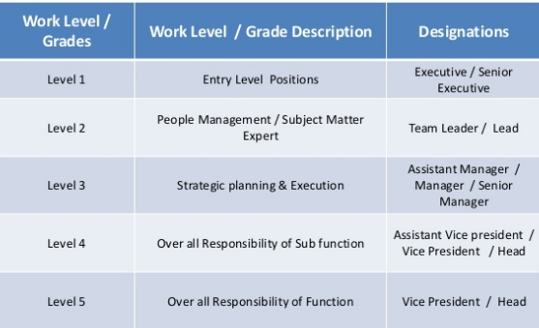
Career path in HR

Slide 12
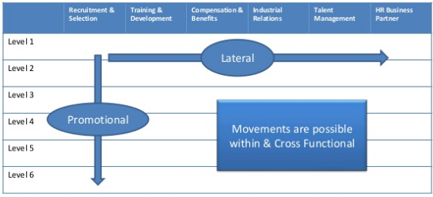
Career path in HR

